Slide 1
Course Name: Machine Learning for Theory and Practices(CSE 623) Submitted To – Prof. (Dr.) Mehul Rawal Group Details: Rampal Singh (AU 2449006)
Project Name:
Predicting Tensile Strength in 3D-Printed Materials using Linear Regression AdaBoost Regression XGBoost Regression ,Gradient Boosting Regression Random Forest Regression

Slide 2
Outline of Presentation
Perform Hyper
parameter tuning using GridSearch
CV Random
SearchCV
Prediction of Tesile strength of research paper data using previous ML Model (RFG)
Merging This data with Kaggle Data and trained Model Using Updated Data
Perform 5 fold cross Validation and compare results of before CV & After CV
Future
Scope
&
Conclusion
Objectives
Previous Comments

Slide 3
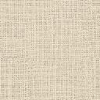
Problem statement
To design and evaluate machine learning models capable of accurately predicting the tensile strength of 3D-printed parts by analyzing key Fused Deposition Modeling (FDM) process parameters such as layer height, wall thickness, infill density, nozzle temperature, print speed, and material type
To evaluate and compare the performance of multiple regression models (including Random Forest, Gradient Boosting, XGBoost, AdaBoost, and Linear Regression) using metrics such as R² and MSE, with and without hyperparameter tuning
To use techniques like Permutation Importance and SHAP to explain which features contribute most to the predictions.

Slide 4
Previous comments
Utilize additional data from the literature to enhance tensile strength predictions and integrate this data with the existing dataset. Retrain the model and analyze the subsequent changes in MSE and R² values.
Perform hyperparameter tuning on AdaBoost Regression, XGBoost Regression, Gradient Boosting Regression, and Random Forest Regression to evaluate their impact on Mean Squared Error (MSE) and the coefficient of determination (R²).
Employ various feature importance techniques and compare the observed trends with findings from existing literature.

Slide 5
Table 1- R² and MSE (Train and Test) Values of Merged 3D printer dataset from Kaggle and Research paper data
Model | R² (Train) | R² (Test) | MSE (Train) | MSE (Test) | performance of model trained on kaggle data
Linear Regression | 0.5482 | 0.6423 | 40.3381 | 21.5732
AdaBoost Regression | 0.8606 | 0.603 | 12.4491 | 23.9409
XGBoost Regression | 1 | 0.6589 | 0.0002 | 20.5727
Gradient Boosting Regression | 0.9618 | 0.7062 | 3.4153 | 17.7187
Random Forest Regression | 0.9382 | 0.7891 | 5.5207 | 12.7192
Model | R² (Train) | R² (Test) | MSE (Train) | MSE (Test) | performance of model trained and research paper
Linear Regression | 0.5469 | 0.6785 | 24.7431 | 17.5779
AdaBoost Regression | 0.8077 | 0.7719 | 10.5028 | 12.4723
XGBoost Regression | 1 | 0.8042 | 0.002 | 10.7058
Gradient Boosting Regression | 0.9405 | 0.8734 | 3.2511 | 6.9228
Random Forest Regression | 0.9276 | 0.8152 | 3.9549 | 10.1049

Slide 6
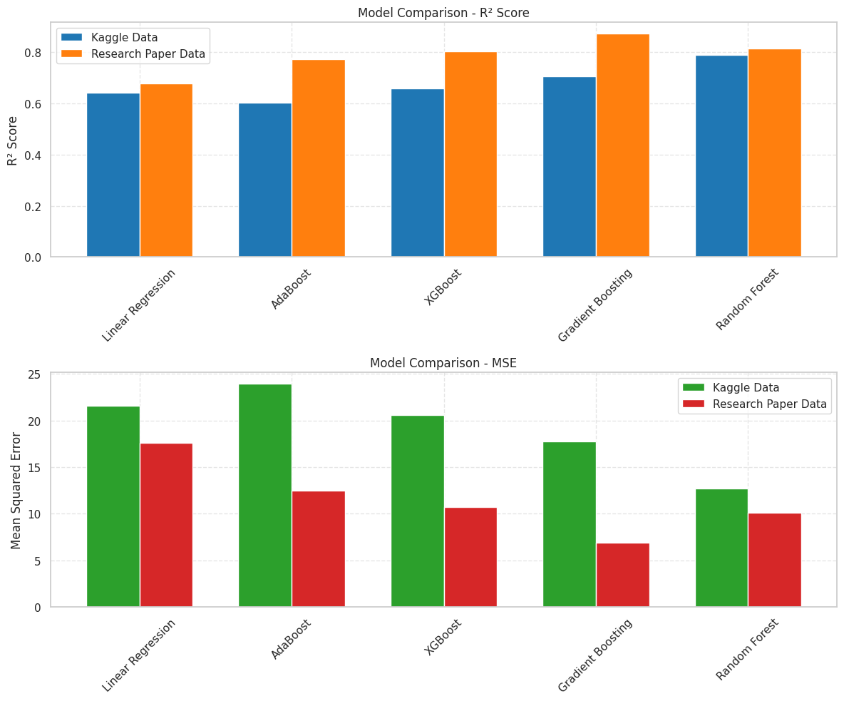
Figure 1- R² and MSE (Train and Test) Values of Merged 3D printer dataset from Kaggle and Research paper data

Slide 7
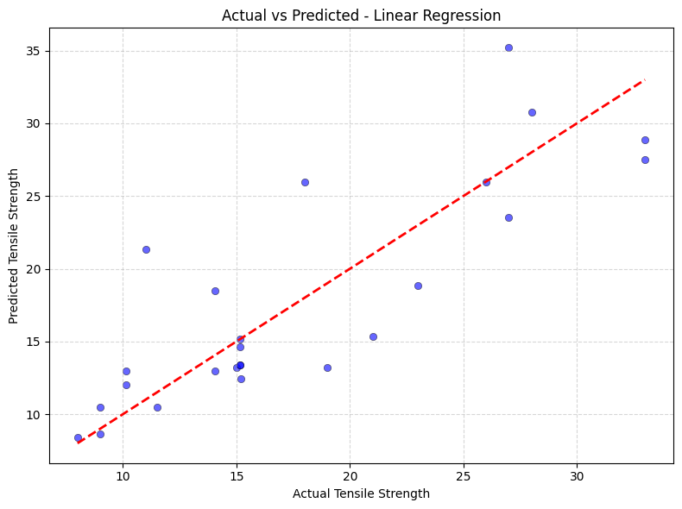
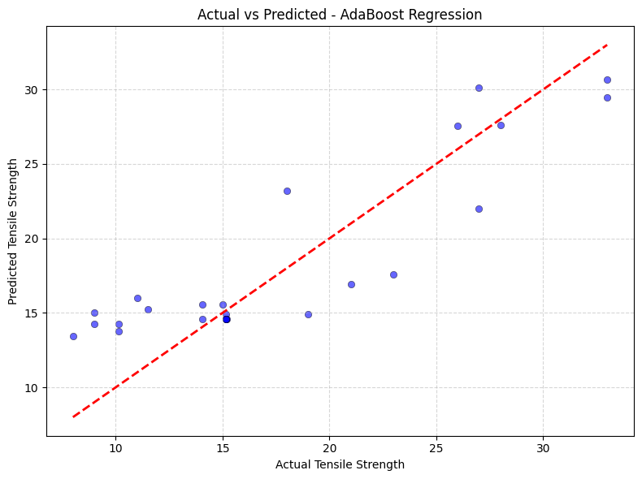
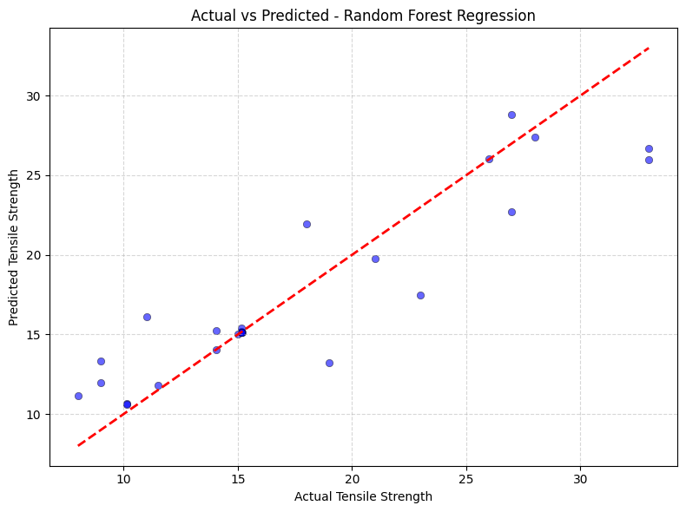
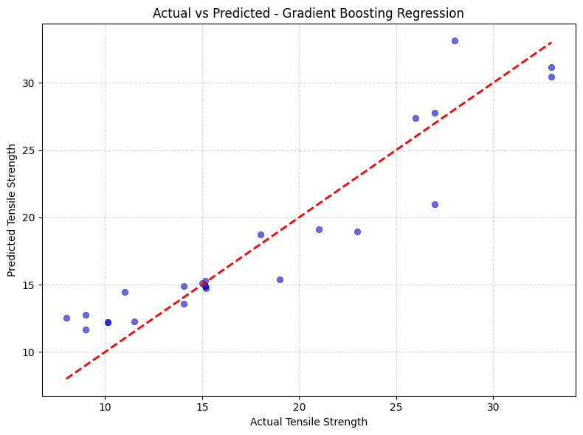
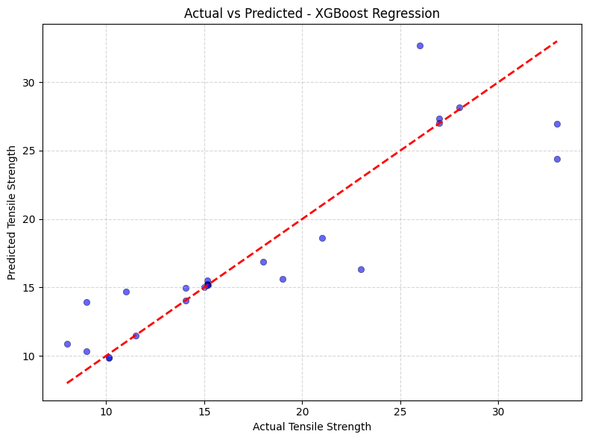
Actual Vs Predcited Tensile Strength Using Different Methods

Slide 8
Table 2- CROSSFLOD VALIDATION
Model | Test R² (Without CV) | Test R² (CV) | Test MSE (Without CV) | Test MSE (CV)
Linear Regression | 0.6785 | 0.9181 | 17.5779 | 23.7128
AdaBoost Regression | 0.7719 | 0.8822 | 12.4723 | 33.9169
XGBoost Regression | 0.8042 | 0.8649 | 10.7058 | 39.0028
Gradient Boosting Regression | 0.8734 | 0.8761 | 6.9228 | 35.7538

Slide 9
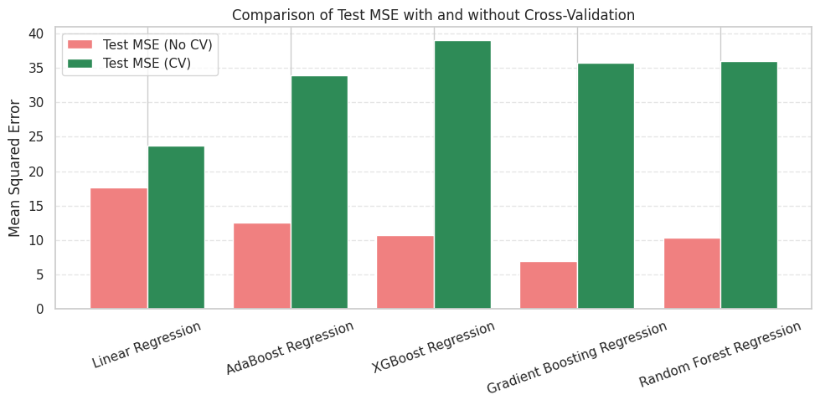
Comparison of Test MSE with and Without Cross Validation

Slide 10
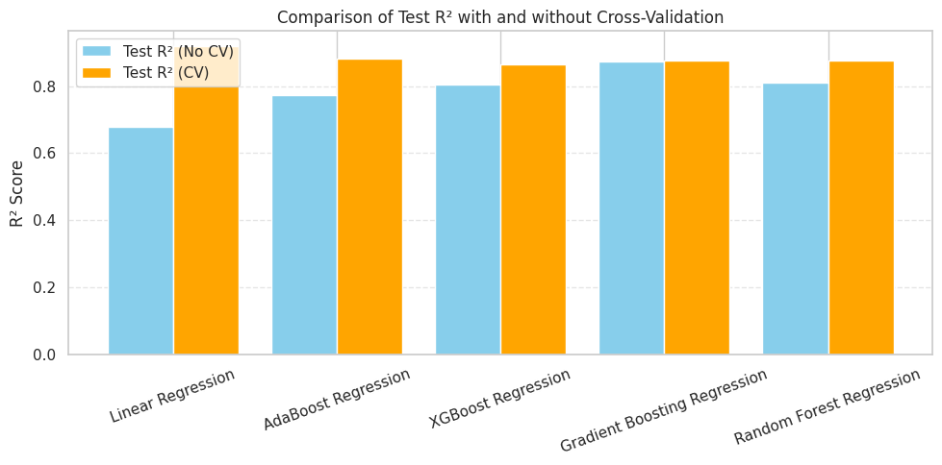
Comparison of Test MSE with and Without Cross Validation

Slide 11
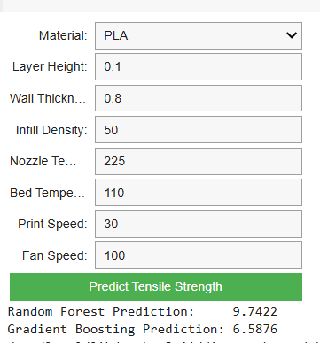
User interface to predict tensile strength

Slide 12
Model | Search Method | Best Parameters | R² Score (Test) | MSE (Test)
AdaBoost Regression | RandomizedSearchCV | {'learning_rate': 0.1896, 'n_estimators': 152} | 0.7790 | 12.0794
 | GridSearchCV | {'learning_rate': 1.0, 'n_estimators': 200} | 0.7741 | 12.3495
XGBoost Regression | RandomizedSearchCV | {'learning_rate': 0.1952, 'max_depth': 4, 'n_estimators': 71} | 0.8787 | 6.6319
 | GridSearchCV | {'learning_rate': 0.2, 'max_depth': 3, 'n_estimators': 200} | 0.8825 | 6.4257
Gradient Boosting | RandomizedSearchCV | {'learning_rate': 0.1952, 'max_depth': 4, 'n_estimators': 71} | 0.9070 | 5.0861
 | GridSearchCV | {'learning_rate': 0.2, 'max_depth': 3, 'n_estimators': 200} | 0.8251 | 9.5616
Random Forest Regression | RandomizedSearchCV | {'max_depth': 20, 'min_samples_leaf': 2, 'min_samples_split': 4, 'n_estimators': 124} | 0.7964 | 11.1311
 | GridSearchCV | {'max_depth': None, 'min_samples_split': 2, 'n_estimators': 100} | 0.8278 | 9.4160
Linear Regression | GridSearchCV | Default parameters used (no tuning) | 0.6785 | 17.5779

Slide 13
R^2 comparison before and after hyper parameter tuning
Model | Before Tuning | After Tuning (GridSearchCV) | After Tuning (Randomized SearchCV)
AdaBoost | 0.7719 | 0.7741 | 0.779
Gradient Boosting | 0.8734 | 0.8251 | 0.906966
Random Forest | 0.8111 | 0.8278 | 0.796391
XGBoost | 0.8042 | 0.8825 | 0.878691

Slide 14
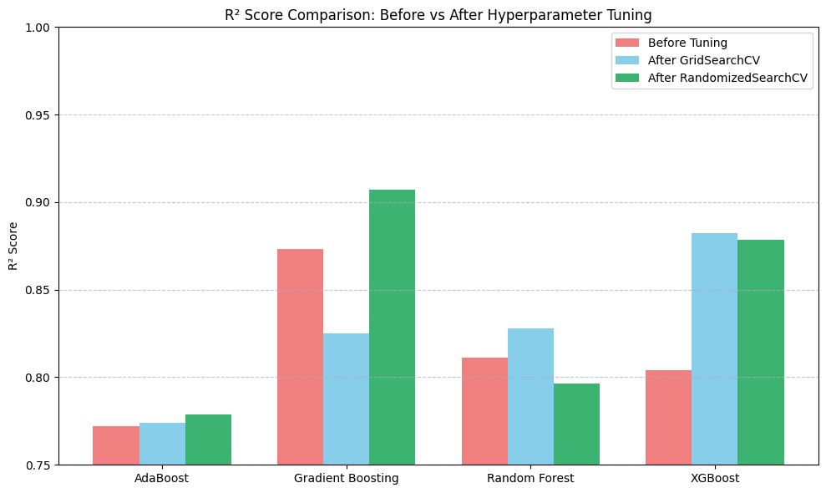
R^2 comparison before and after hyper parameter tuning

Slide 15
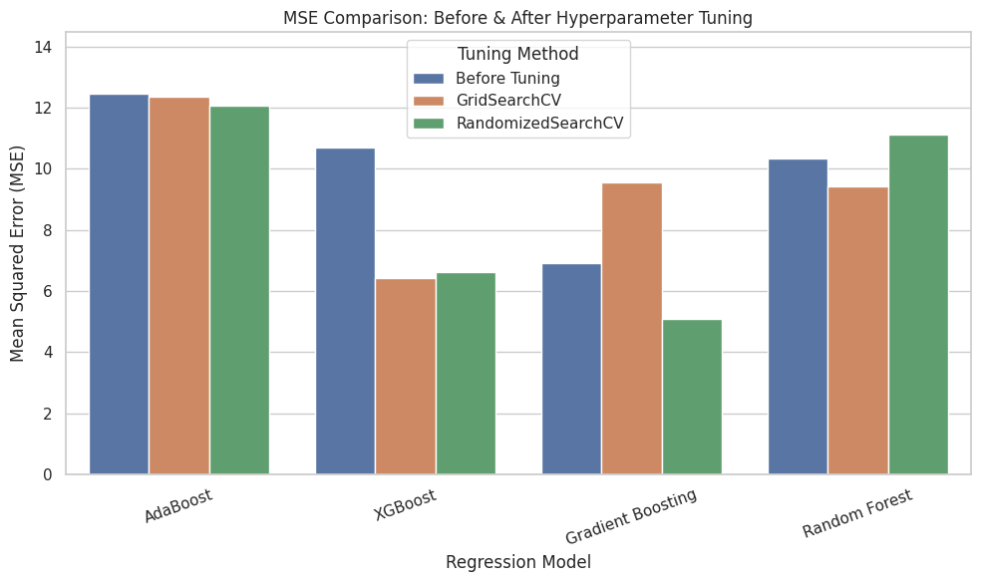

Slide 16
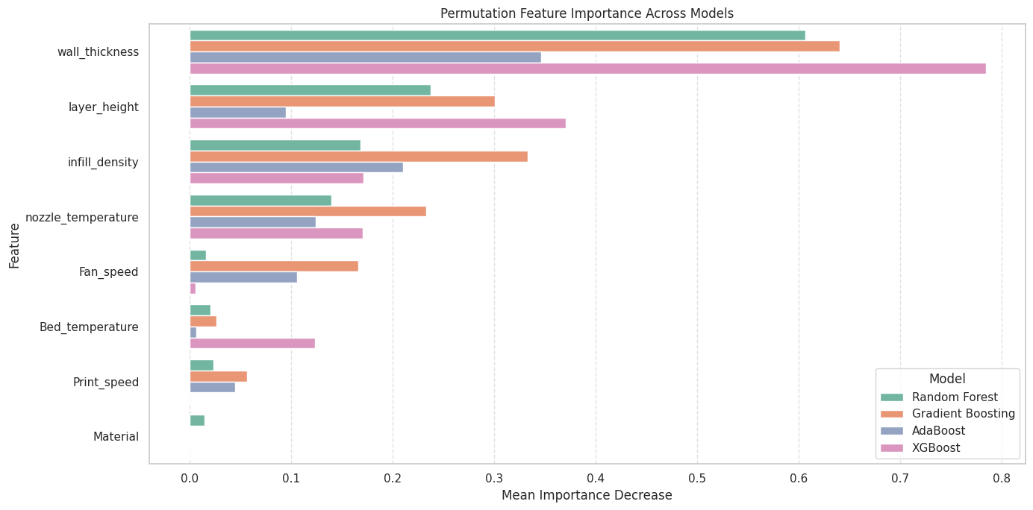
Permutation Feature Importance

Slide 17
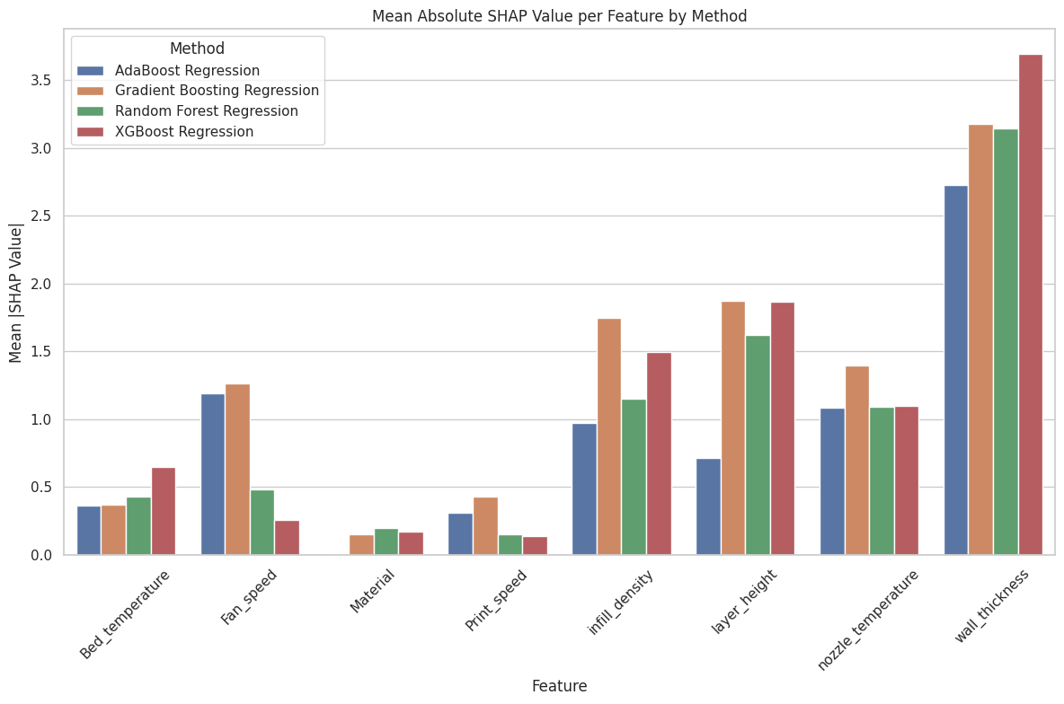
Mean Absolute SHAP (SHapley Additive exPlanations.) Value per Feature

Slide 18
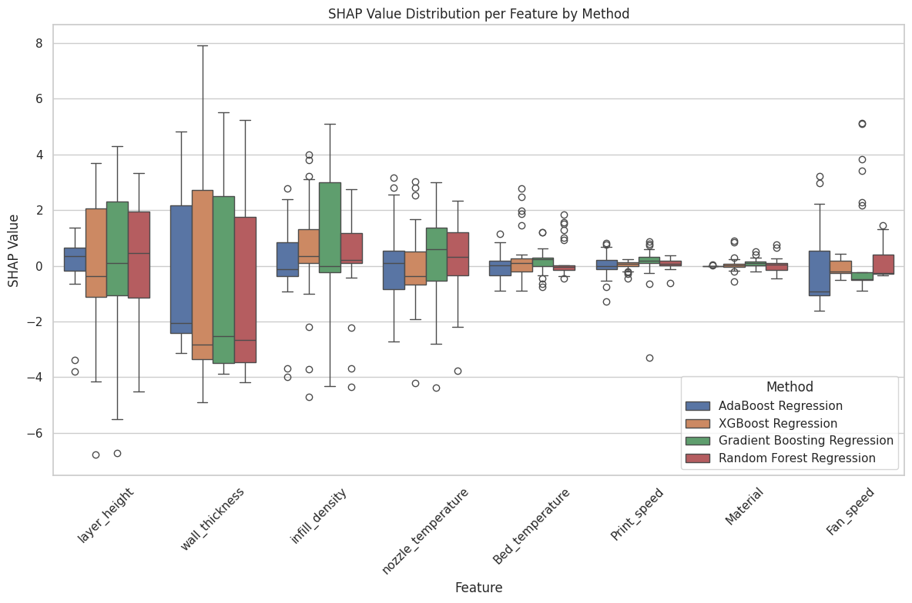
SHAP Value Distribution per feature by methods

Slide 19

Future Scope:
Integration with Real-Time 3D Printing Systems:
The trained models can be embedded into 3D printers or slicing software to predict and optimize tensile strength in real time before printing, helping users choose the best parameters.
Expansion to Other Mechanical Properties:
Future work can extend beyond tensile strength to include properties like flexural strength, impact resistance, surface roughness, and dimensional accuracy, making the prediction model more comprehensive.
Inclusion of Advanced Materials and Composite Filaments:
The model can be enhanced by including new-age materials like carbon fiber-reinforced PLA, PETG, and Nylon, making it suitable for industrial applications.
Deployment as a Web or Mobile Application:
The prediction system can be turned into a user-friendly app or dashboard for manufacturers and engineers to input parameters and instantly get strength predictions.

Slide 20
Conclusion
Objective Achieved: Developed and validated multiple regression models (Linear, AdaBoost, XGBoost, Gradient Boosting, Random Forest) to predict 3D‑printed part tensile strength from process parameters.
Top Performer: Random Forest Regression emerged best‑in‑class, achieving R² ≈ 0.88 on test data after hyperparameter tuning (vs. 0.81 before tuning).
Robust Generalization: 5‑fold cross‑validation confirmed stability (CV Test R² ≈ 0.88; CV Test MSE ≈ 35), mitigating overfitting concerns.
Key Drivers Identified: Feature importance and SHAP analysis consistently highlighted layer height, wall thickness, and nozzle temperature as the most influential parameters.
Practical Impact: Enables data‑driven optimization of 3D‑printing settings—boosting part durability while reducing costly trial‑and‑error.
User Interface: Interactive widget prototype allows real‑time tensile strength predictions for custom parameter inputs.

Slide 21
References
Delli, U., & Chang, S. (2018). Automated process monitoring in 3D printing using supervised machine learning. Procedia Manufacturing, 26, 865–870. https://doi.org/10.1016/j.promfg.2018.07.111
Jayasudha, M., Elangovan, M., Mahdal, M., & Priyadarshini, J. (2022). Accurate estimation of tensile strength of 3D printed parts using machine learning algorithms. Processes, 10(6), 1158. https://doi.org/10.3390/pr10061158
Tatar, A. B. (2025). Predicting three-dimensional (3D) printing product quality with machine learning-based regression methods. Fırat University Journal of Experimental and Computational Engineering, 4(1), 206–225. https://doi.org/10.62520/fujece.1604379
Sharma, P., Vaid, H., Vajpeyi, R., Shubham, P., Agarwal, K. M., & Bhatia, D. (2022). Predicting the dimensional variation of geometries produced through FDM 3D printing employing supervised machine learning. Sensors International, 3, 100194. https://doi.org/10.1016/j.sintl.2022.100194

Slide 22
Dataset Discussion
Aspect | Details
Dataset Source | Experimental data collected from kaggle and Research papers
Features Considered | - Wall Thickness
 | - Infill Density
 | - Layer Height
 | - Bed Temperature
 | - Nozzle Temperature
 | - Fan Speed
 | - Print Speed
Target Variable | Tensile Strength
Data Pre-processing Steps | - Removed non-numeric data
 | - Handled missing values by imputing with the column mean
 | - Split data into training (80%) and testing (20%) sets
Source of kaggle data -https://www.kaggle.com/datasets/afumetto/3dprinter?select=data.csv

Slide 23
Data Pre-processing
Dropped irrelevant labels like Roughness and Elongation (not the current target)
Removed non-numeric or redundant features
Encoded categorical features like Material and Infill Pattern
Handled missing values using mean imputation
The Infill Pattern was excluded from the model due to its low correlation coefficient of 0.28 with Tensile Strength, indicating a weak relationship. It was also seldom cited in relevant 3D printing research as a significant factor.

Slide 24
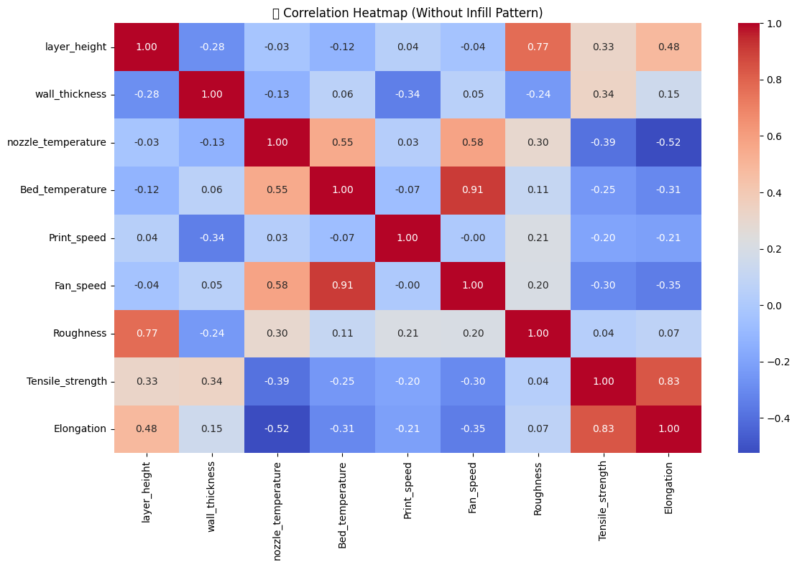
5. Exploratory Data Analysis (EDA)

Slide 25
Model Evaluation & Results
train vs. test R², MSE
Model | R² (Train) | R² (Test) | MSE (Train) | MSE (Test)
Linear Regression | 0.5469 | 0.6785 | 24.7431 | 17.5779
AdaBoost Regression | 0.8077 | 0.7719 | 10.5028 | 12.4723
XGBoost Regression | 1 | 0.8042 | 0.002 | 10.7058
Gradient Boosting Regression | 0.9405 | 0.8734 | 3.2511 | 6.9228
Random Forest Regression | 0.9338 | 0.8111 | 3.6165 | 10.3271

